Slide 1
Web Programming 1
FINAL GROUP PROJECT
Group 10
Group members:
M22W0428 – DHANUSHKA MALINDA JAYALATH
M22W0426 – THENNEKOON MUDIYANSELAGE JANITH
JEEWANTHA THENNEKOON

Slide 2

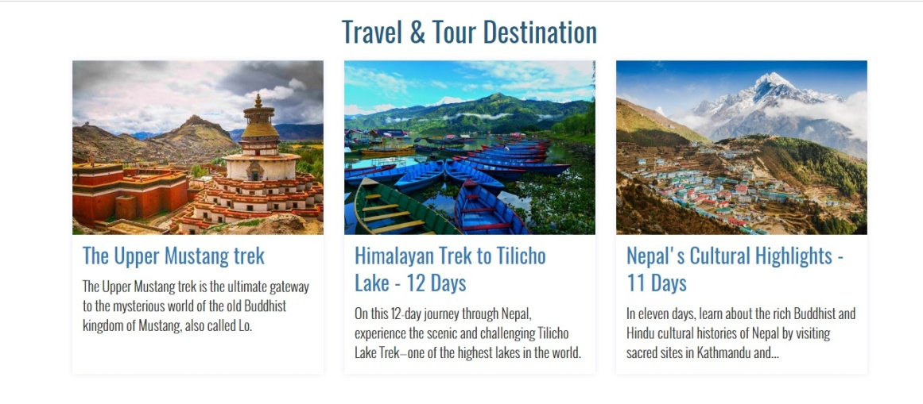
EasyTravel Web
HOME PAGE:

Slide 3

About page

Slide 4
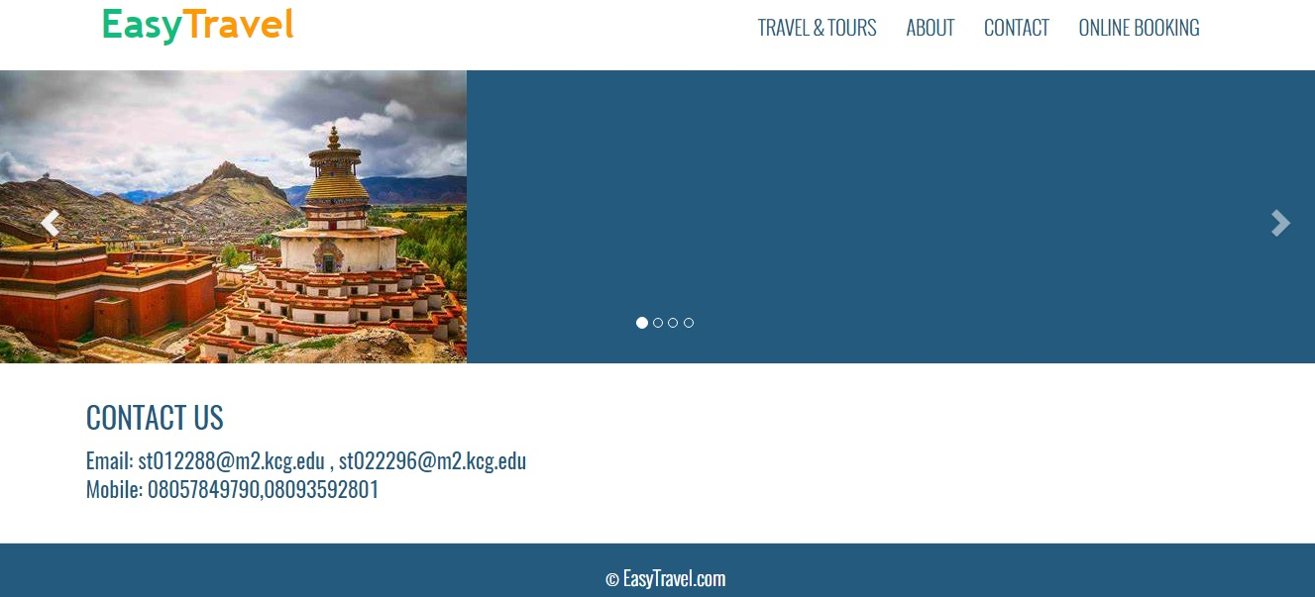
Contact Page

Slide 5
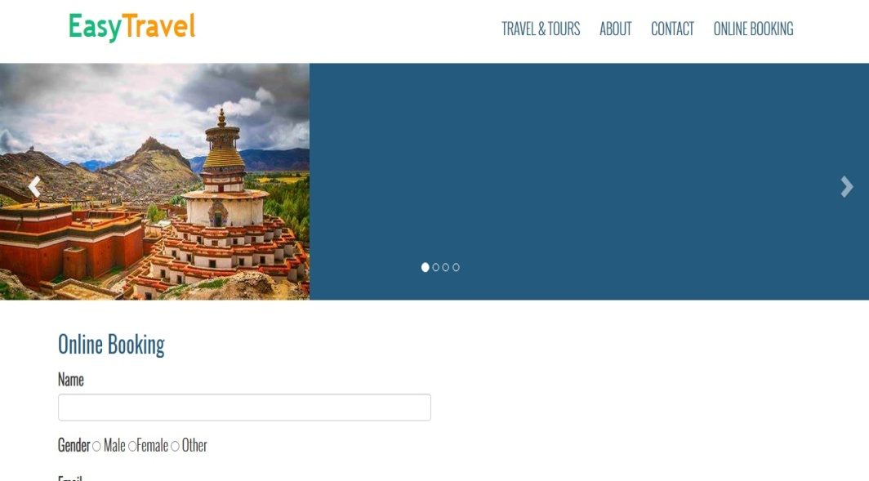
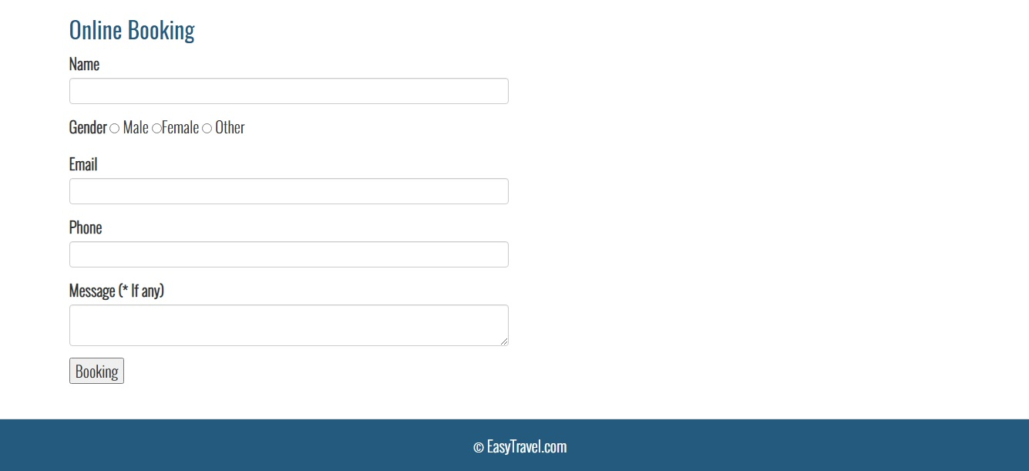
Online Booking Page

Slide 6
THANK YOU

